Slide 1
Clustering for Data Mining: Overview and Examples
Dr. Hsinchun Chen, University of Arizona
Updated April, 2020
Acknowledgements: Wikipedia; Aho & Ullman, “Data Structures & Algorithms”, BioPortal project, NSF, NIH

Slide 2
Outline
Introduction and Motivation
Terminology
Popular clustering algorithms & applications
Major Clustering Algorithms
Centroid-based clustering: K-means
Connectivity-based clustering: Single-link hierarchical clustering
Density-based clustering: SaTScan
Distribution-based clustering: Gaussian mixture model
Research Example: BioPortal for Public Health, 2000-2012

Slide 3
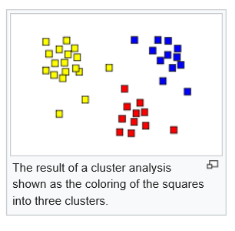
Introduction and Motivation: Clustering
Clustering: Clustering or Cluster Analysis is the task of grouping a set of objects or records in such a way that objects/records in the same group (called a cluster) are more similar (in some sense) to each other than to those in other groups (clusters). Clustering is considered unsupervised learning in Data Mining, i.e., no labeled output/dependent variables needed.
Common Clustering Applications:
Computational biology: sequence analysis (group homologous sequences into gene families); human genetic clustering (clustering genetic data to infer population structures)
WWW: SNA community detection (recognize communities or groups within large social groups); search results grouping (intelligent groupings of files or web sites)
Social Science: crime analysis and mapping (hotspot analysis & mapping); public health and syndromic surveillance (hotspot analysis, hierarchical clustering and visualization)

Slide 4
Introduction and Motivation: Clustering
Major Clustering Algorithms:
Centroid-based clustering: Clusters are represented by a central vector and objects are assigned to the nearest cluster center, e.g., k-means.
Connectivity-based clustering (hierarchical clustering): These algorithms connect objects to form clusters based on their distance, e.g., single-link hierarchical clustering.
Density-based clustering: Clusters are defined as areas of higher density than the remainder of the data set, e.g., SatScan, DBSCAN.
Distribution-based clustering: Based on distribution models, clusters can be defined as objects belonging most likely to the same distribution, e.g., Gaussian mixture model.

Slide 5
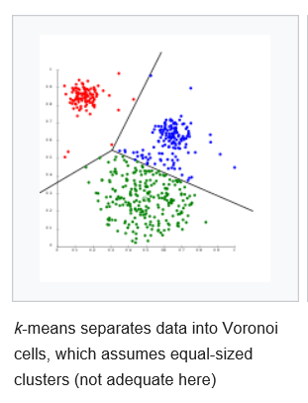
Centroid-based: K-means Algorithm
Pick k points as the initial k cluster representatives or centroids.
Each data points is then assigned to its closet centroid.
Each centroid is relocated to the center (mean) of all data points assigned to it.
The algorithm converges when the assignments no longer change.

Slide 6
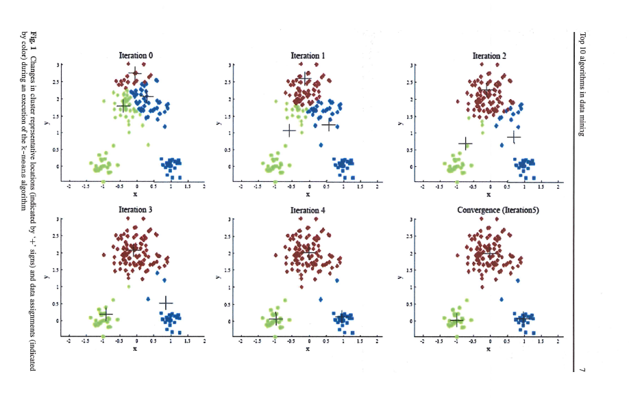
K-means Algorithm: An Example

Slide 7
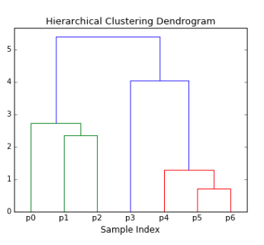
Connectivity-based: Single-link Hierarchical Clustering (Krustal’s Algorithm)
For G = (V, E), sort all edges (E) in increasing order and examine each edge in order.
If each edge connected two vertices in two different connected components, then add the edge to T (a spanning tree); else discard.
Repeat (2) until all edges (V) are in the same connected component (T), stop.
T is a minimum-spanning tree (MST) that connects all nodes with the shortest distance and can be represented as a dendrogram (a hierarchical diagram for representing a tree).

Slide 8
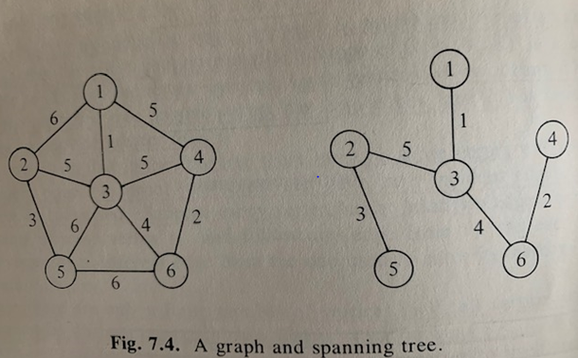
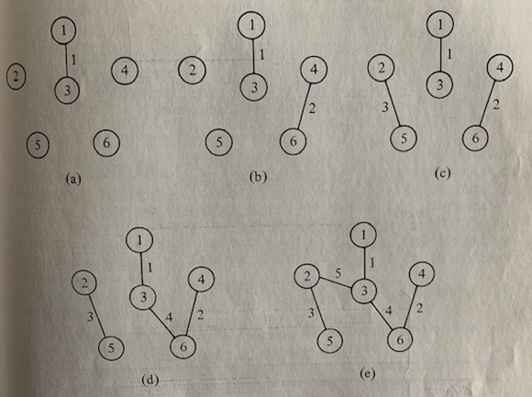
Single-link Hierarchical Clustering (Krustal’s Algorithm) Example: from a MST to a dendrogram
1
3
4
6
2
5

Slide 9
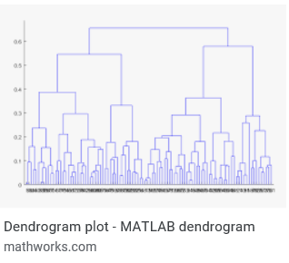
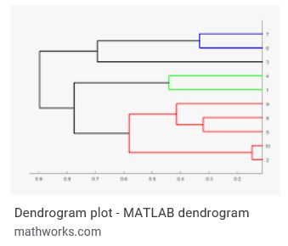
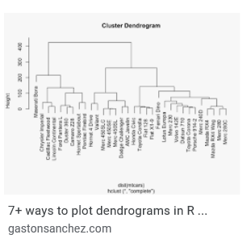
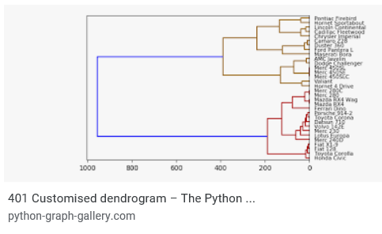
Dendrogram Examples and Tools: MATLAB, R, Python

Slide 10

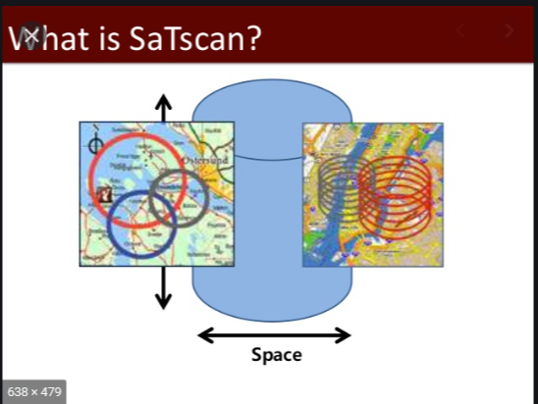
Density-based: SaTScan
Developed by Martin Kulldorf; Mostashari F, Kulldorff M, Hartman J J, Miller J R, Kulasekera V., “Dead bird clusters as an early warning system for West Nile virus activity.” Emerg Infect Dis 2003; (9): 641-646.
Software available at: http://www.satscan.org
Used widely in public health and other fields to identify high or low clusters of illness or other events across space and time.

Slide 11
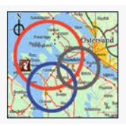
SaTScan Algorithm
A circle (or ellipse) of varying sizes systematically goes across (scans) the study area as it defines a dynamic geographic unit, or moving window (can be over time).
Clusters are reported for those circles where observed values are greater than expected values.
To identify clusters, a likelihood function is maximized across all locations/times. The maximum likelihood indicates the cluster least likely to have occurred by chance.
Probability models such as discrete Poisson & Bernoulli (count data) and Multinomial (ordinal data) are used.
Clusters can be statistically significant or not. The p-value is obtained through Monte Carlo hypothesis testing.

Slide 12
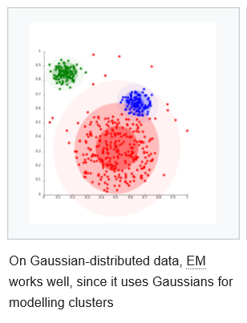
Distribution-based: Gaussian Mixture Model
Clusters are defined as objects belonging most likely to the same distribution.
Data set is usually modeled with a fixed number of Gaussian (normal) distributions (bell curves) that are initialized randomly and whose parameters are iteratively optimized to better fit the data set (using the expectation-maximization algorithm).
Objects are then assigned to the Gaussian distribution they most likely belong to.

Slide 13
Data Analysis and Visualization for Syndromic Surveillance: The BioPortal Experience
Hsinchun Chen, Ph.D.
Artificial Intelligence Lab, U. of Arizona
NSF BioPortal Research Center
Acknowledgement: NSF, CIA, DHS, CDC, NCI

Slide 14
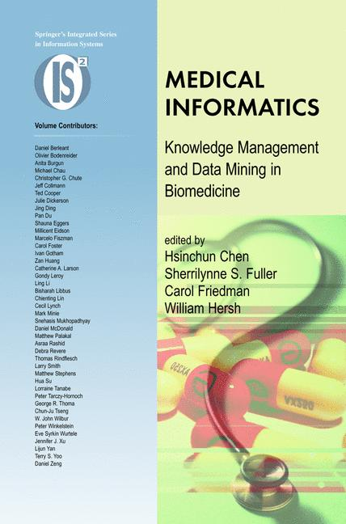
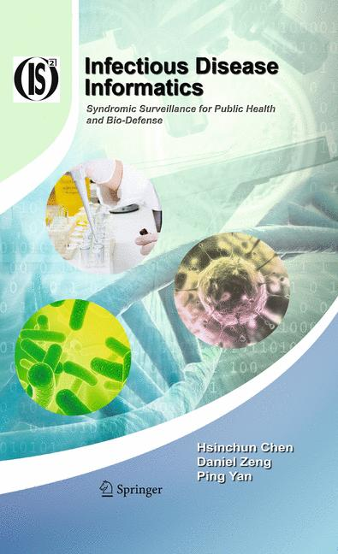
Medical Informatics: The computational, algorithmic, database and information-centric approach to the study of medical and health care problems.
Infectious Disease Informatics: Medical informatics for infectious disease, public health, and biodefence.
Hsinchun Chen et al., 2005
Hsinchun Chen, et al., 2010

Slide 15
Syndromic Surveillance Data Sources in Different Stages of Developing a Disease
Reproduced from Mandl et. al. (2004)

Slide 16
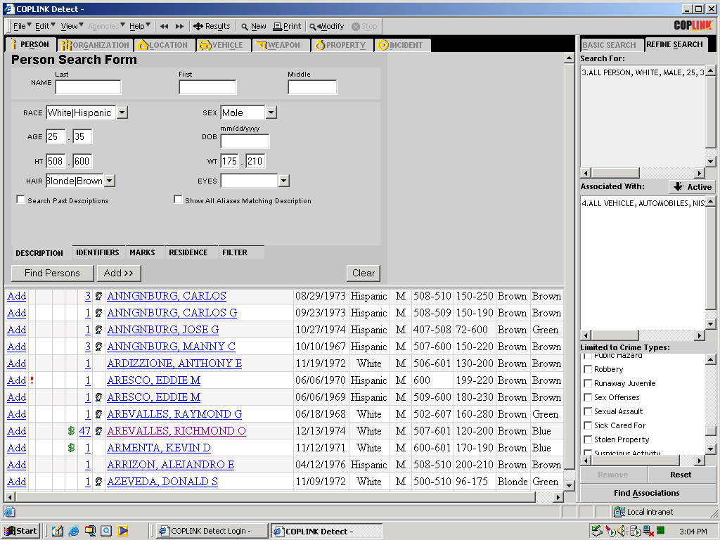
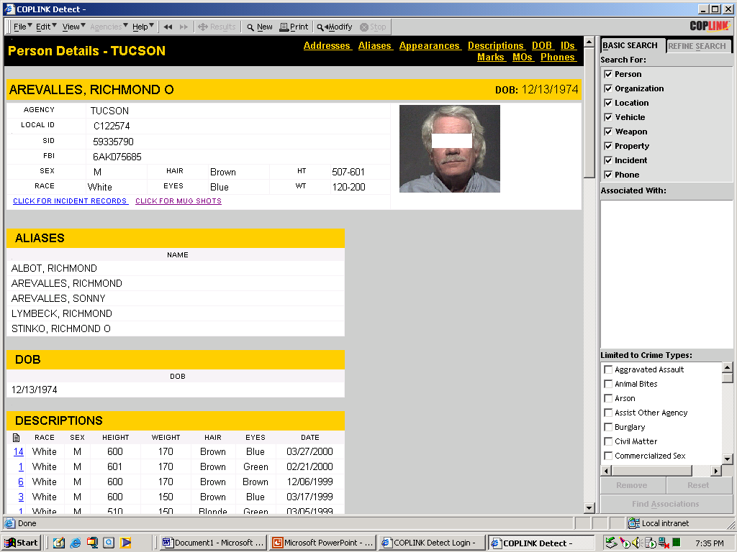
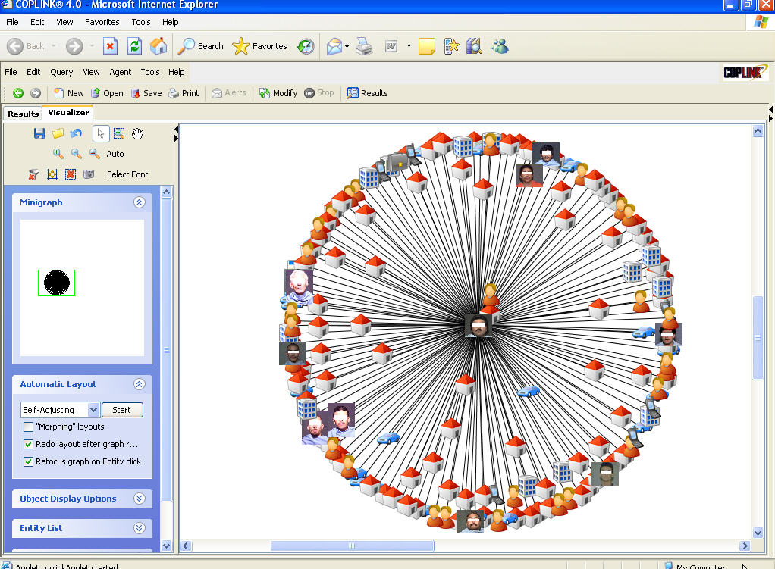
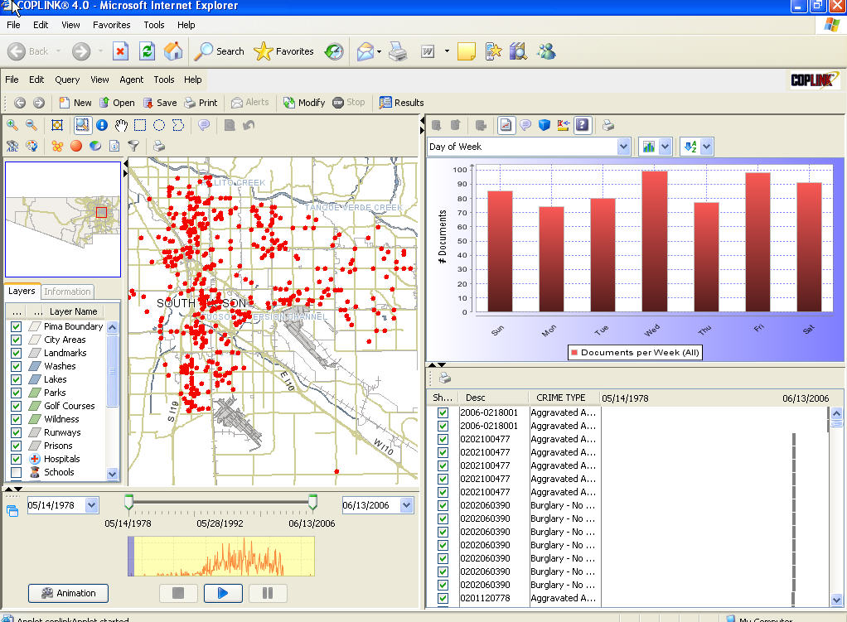
Related Work: COPLINK System

Slide 17
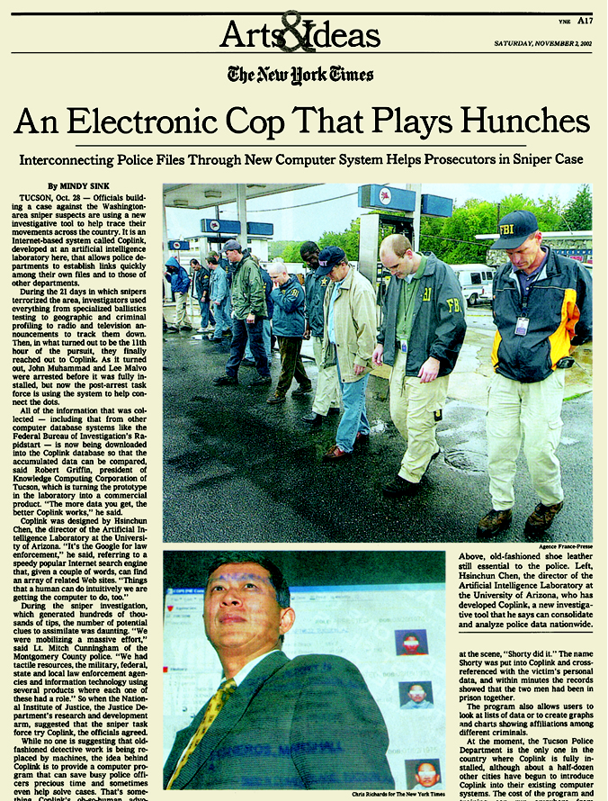
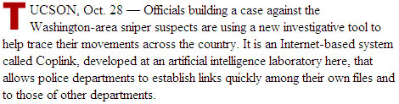
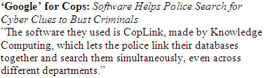

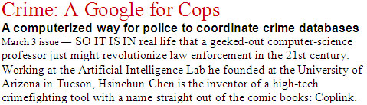

COPLINK News
The New York Times November 2, 2002
ABC News April 15, 2003
Newsweek Magazine March3, 2003

Slide 18
BioPortal: Overview, West Nile Virus
(hotspot analysis & visualization, SaTScan, RSVC)

Slide 19
Spatial-Temporal Visualization
Integrates four visualization techniques
GIS View
Periodic Pattern View
Timeline View
Central Time Slider
Visualizes the events in multiple dimensions to identify hidden patterns
Spatial
Temporal
Hotspot analysis
Phylogenetic tree
Contact network analysis
Notes:
One of the important functionalities of BioPortal is to provide visual data analysis support
Spatial Temporal Visualization STV, is first developed to visualize criminal incidents.
When we started this BioPortal project we found there are common characters between criminal and disease events
It is useful to visualize infectious disease information in STV
Integrates three types of visualization techniques
GIS View
Periodic Pattern View
Timeline View
Central Time Slider
Visualizes the events in both spatial and temporal dimensions so the patterns can be discovered quickly

Slide 20
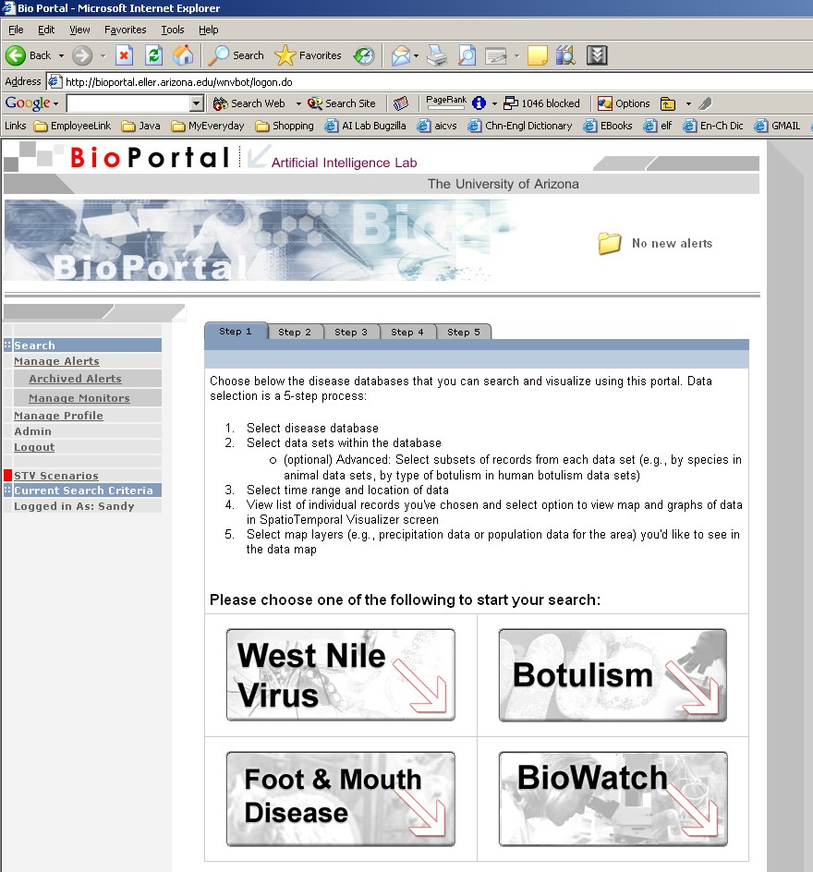
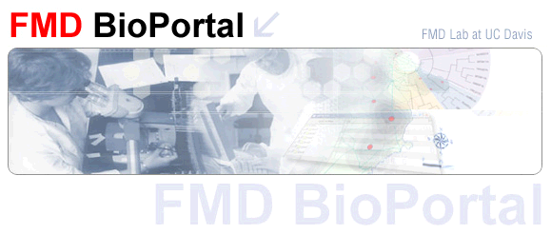

BioPortal Prototype Systems

Slide 21
Outbreak Detection & Hotspot Analysis
Hotspot is a condition indicating some form of clustering in a spatial and temporal distribution (Rogerson & Sun 2001; Theophilides et. al. 2003; Patil & Tailie 2004; Zeng et. al. 2004; Chang et. al. 2005)
For WNV, localized clusters of dead birds typically identify high-risk disease areas (Gotham et. al. 2001); automatic detection of dead bird clusters can help predict disease outbreaks and allocate prevention/control resources effectively
Notes:
We now discuss the last technical component of the WNV/BOT Portal, which is predictive modeling and hotspot analysis.
Hotspot indicates some form of clustering in a spatial and temporal distribution.
For WNV, clustering of dead birds, or more specifically dead crows, typically identify high-risk disease areas.
The goal of using hotspot analysis in the context of WNV is to detect automatically unusual dead bird clusters. In turn, such information can be used to predict disease outbreaks and help guide prevention/control activities.

Slide 22
Retrospective Hotspot Analysis
Notes:
Let’s get some concrete idea about the baseline information. Normally the data are distributed like this, we call them baseline data. then red crosses mean new coming data. Compared with the baseline data, obviously, there is a dense area at the right hand site that contain lots of cross dots. The left dense area is not our focus because it’s normal. We only concern about emerging cluster.

Slide 23
Risk-Adjusted Support Vector Clustering (RSVC)
Feature space
Minimum sphere
Split into several clusters
High baseline density makes two points far apart in feature space
Estimate baseline density
Notes:
The example of how RSVC works. Here are the data, we estimate the baseline density. All the data are mapped into a feature space. Fine a minimum sphere to cover all the data. This is the standard support vector clustering, our modification it that we modify some distance calculation formula and makes two points far apart in feature space if the region they reside in original space have high baseline density The boundary of the minimum sphere split into several arbitrary shape clusters when mapping back to original space

Slide 24
Study II: NY WNV (birds, mosquitoes, and humans)
On May 26, 2002, the first dead bird with WNV was found in NY
Based on NY’s test dataset
140 records
224 records
March 5
May 26
July 2
baseline
new cases

Slide 25
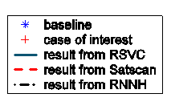
Dead Bird Hotspots Identified

Slide 26
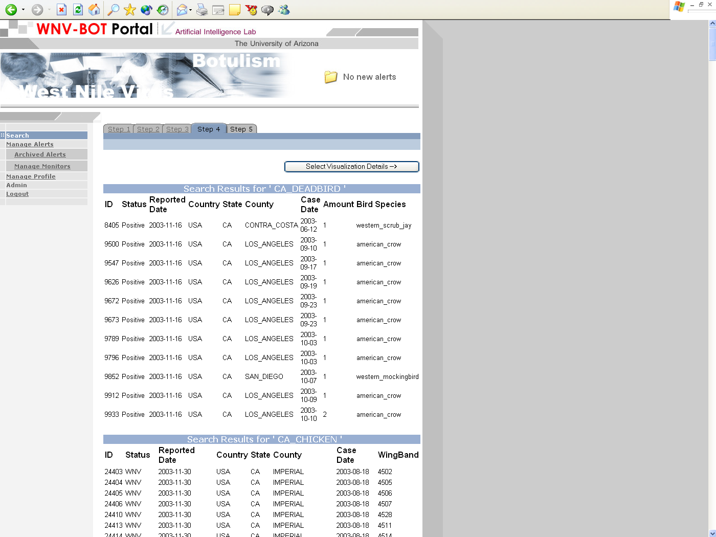
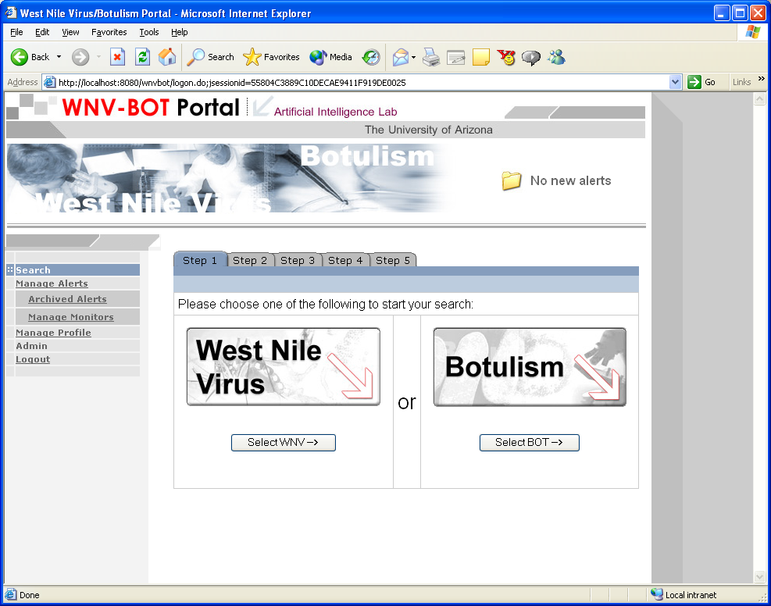
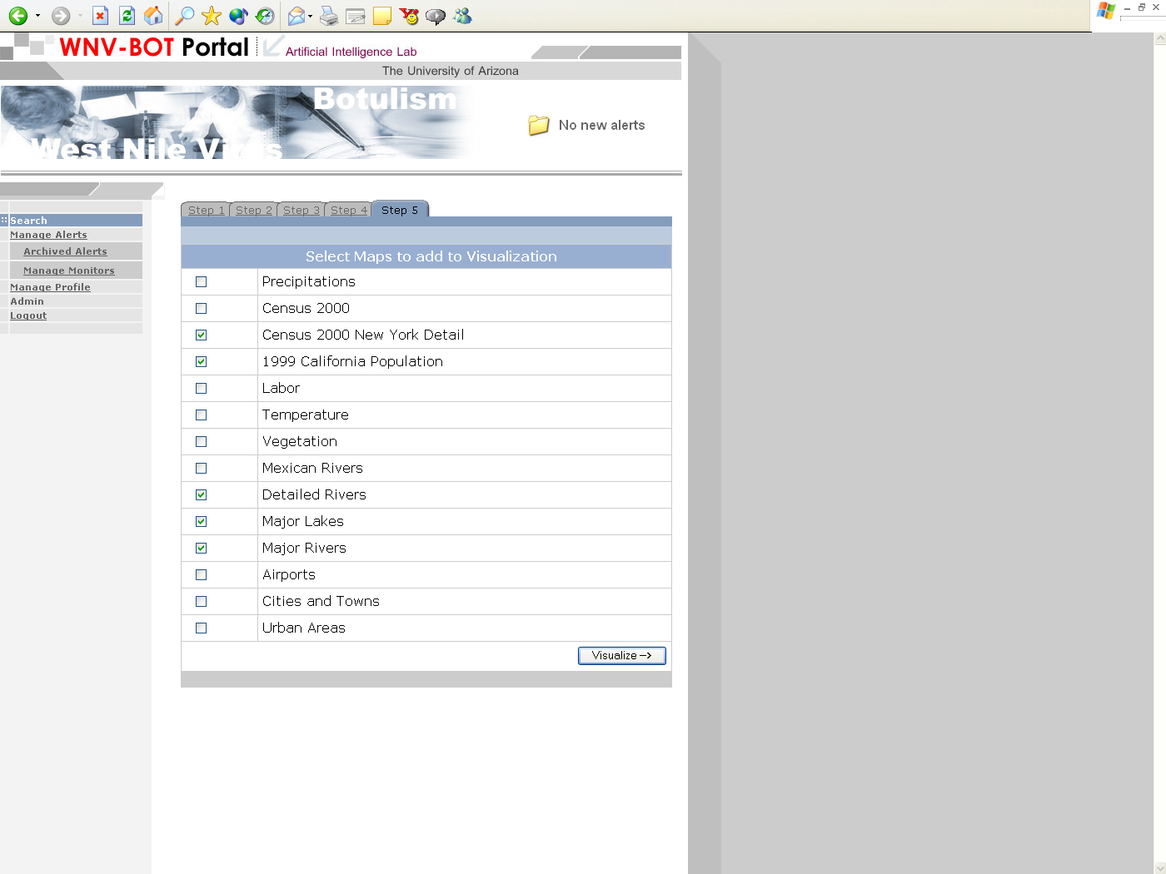
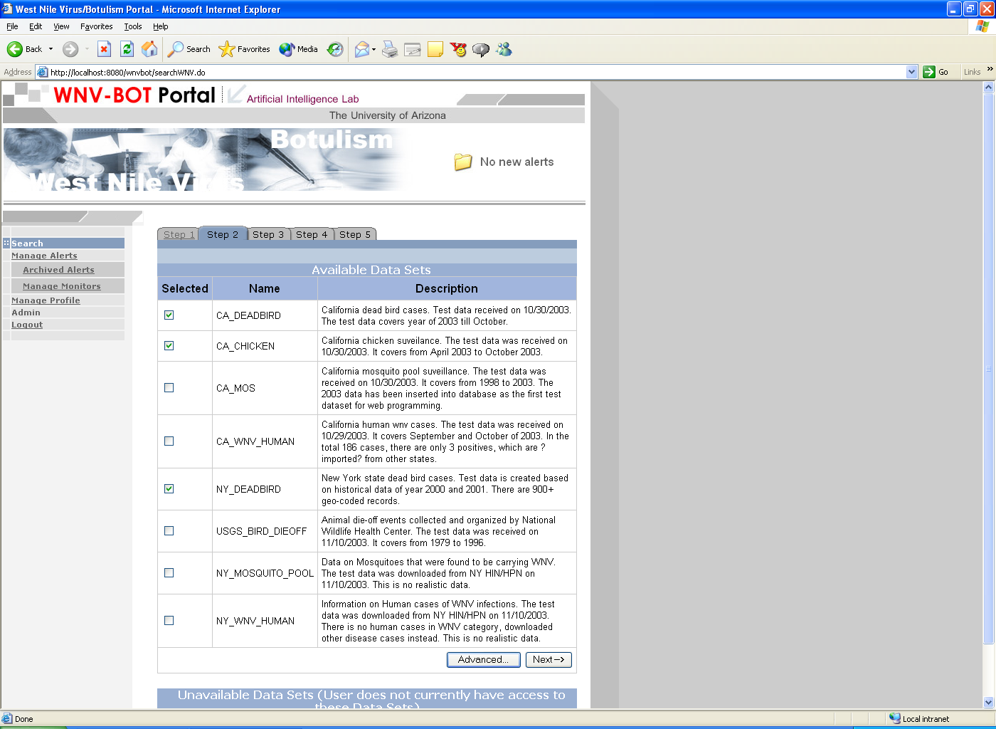
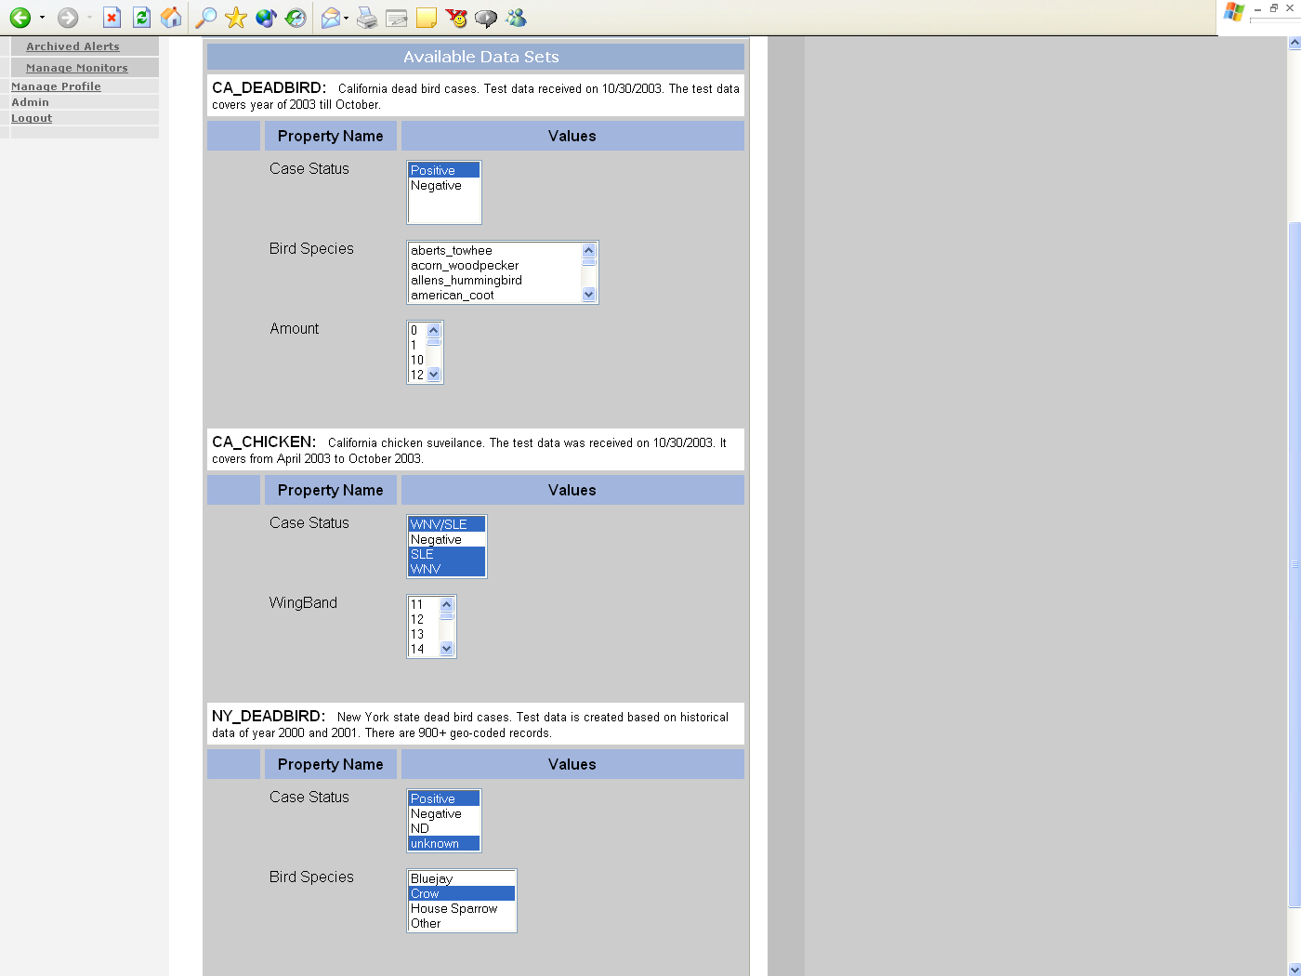
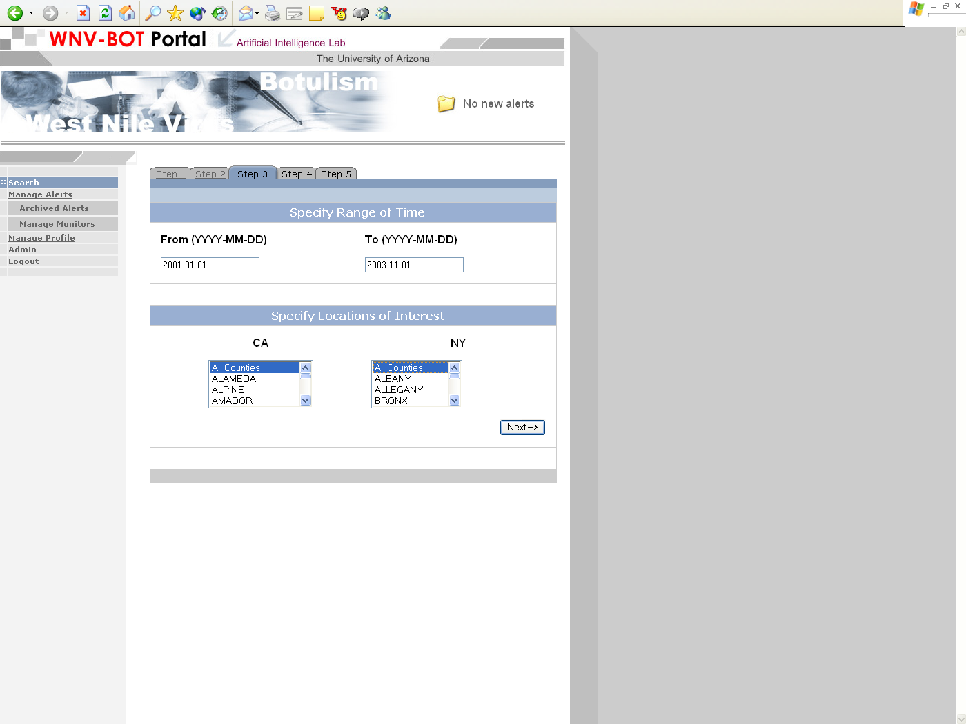
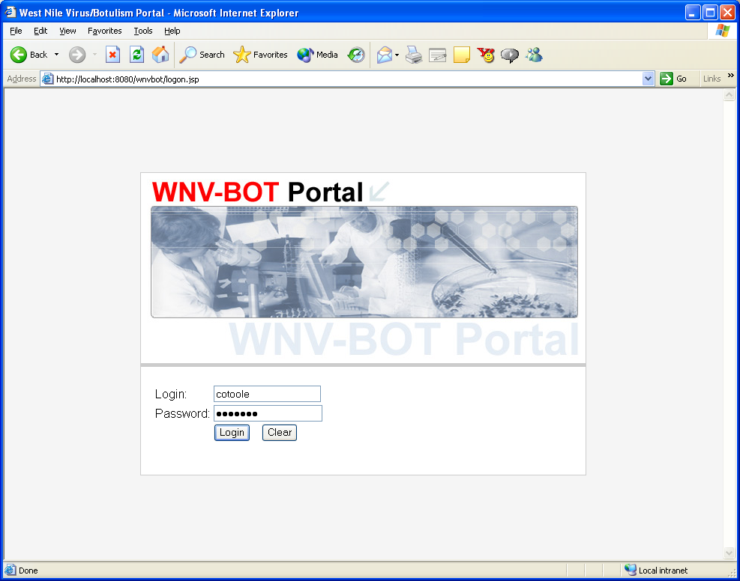
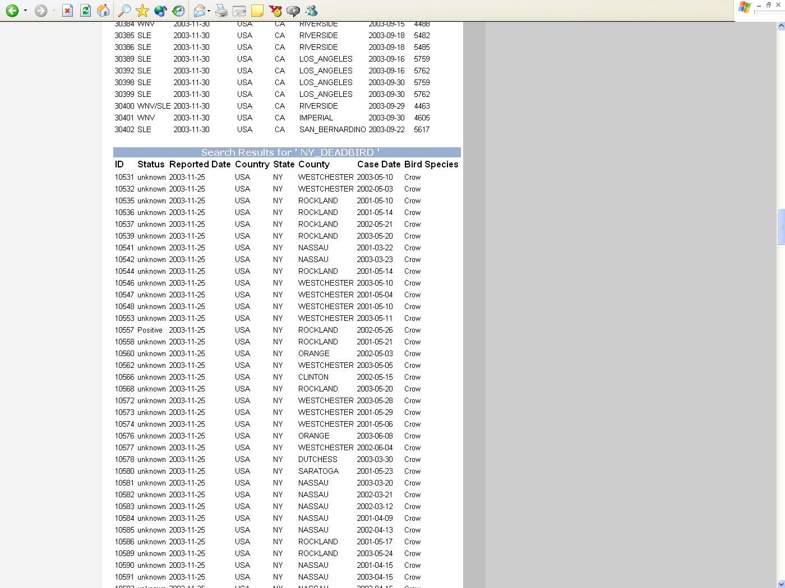
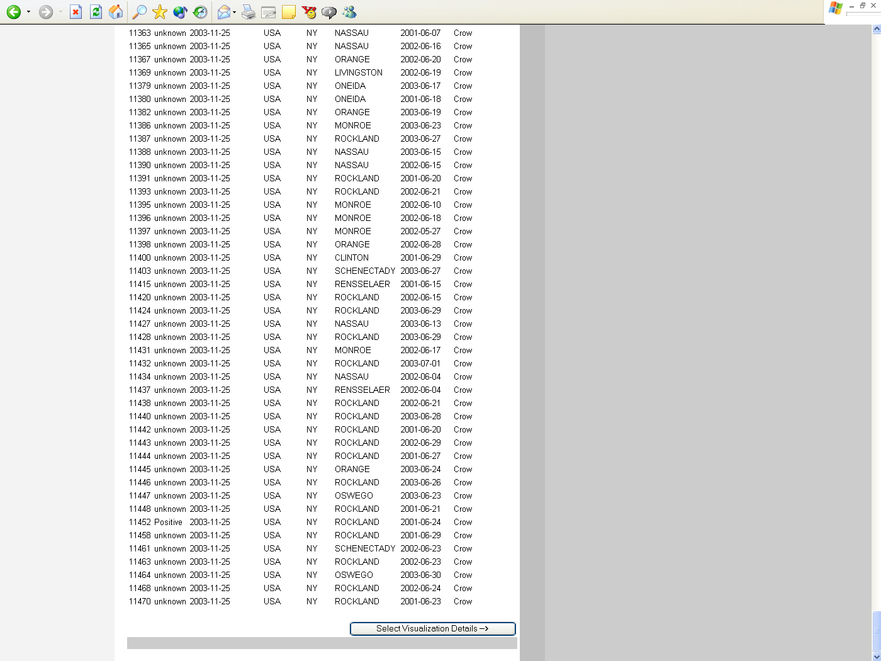
Dataset name
Advanced Search criteria
Spatial / Temporal
Select background maps
Results listed in table
Available dataset list
Positive cases
User main page
Time range
Select NY / CA population, river and lakes
County / State
Choose WNV disease data
Select CA dead bird, chicken and NY dead bird data
Select CA dead bird, chicken and NY dead bird data
Positive cases
User Login
Positive cases
Start STV
Specify bird species

Slide 27
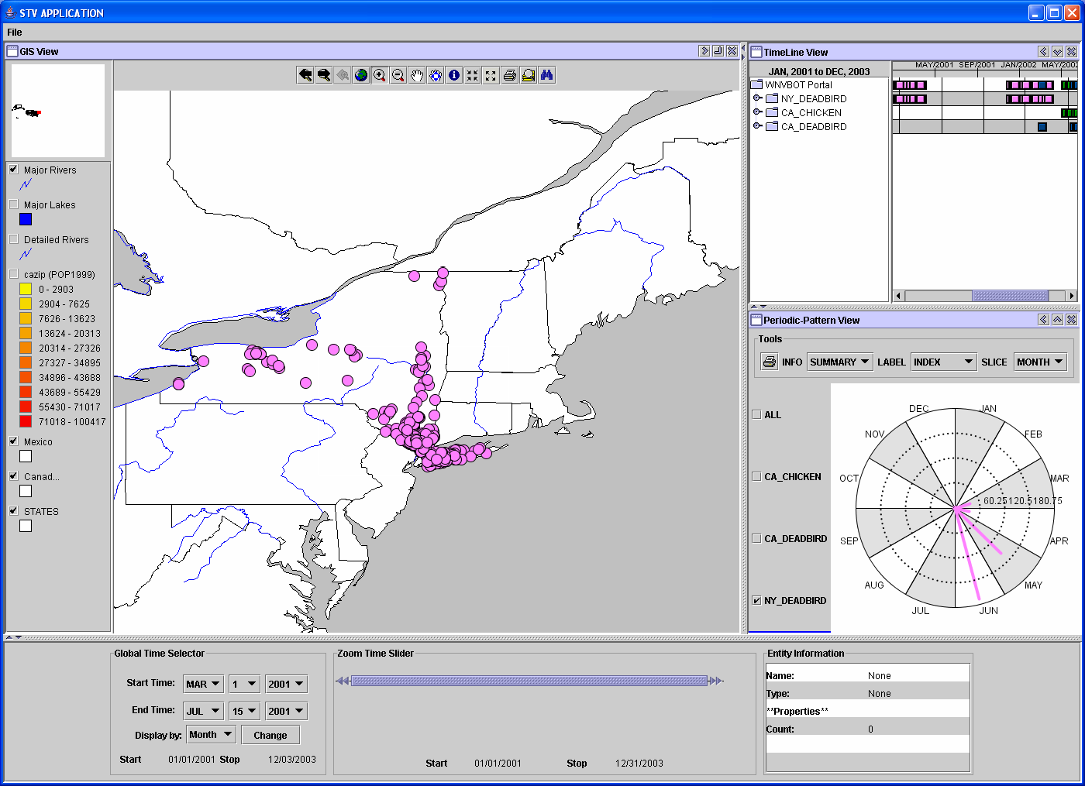
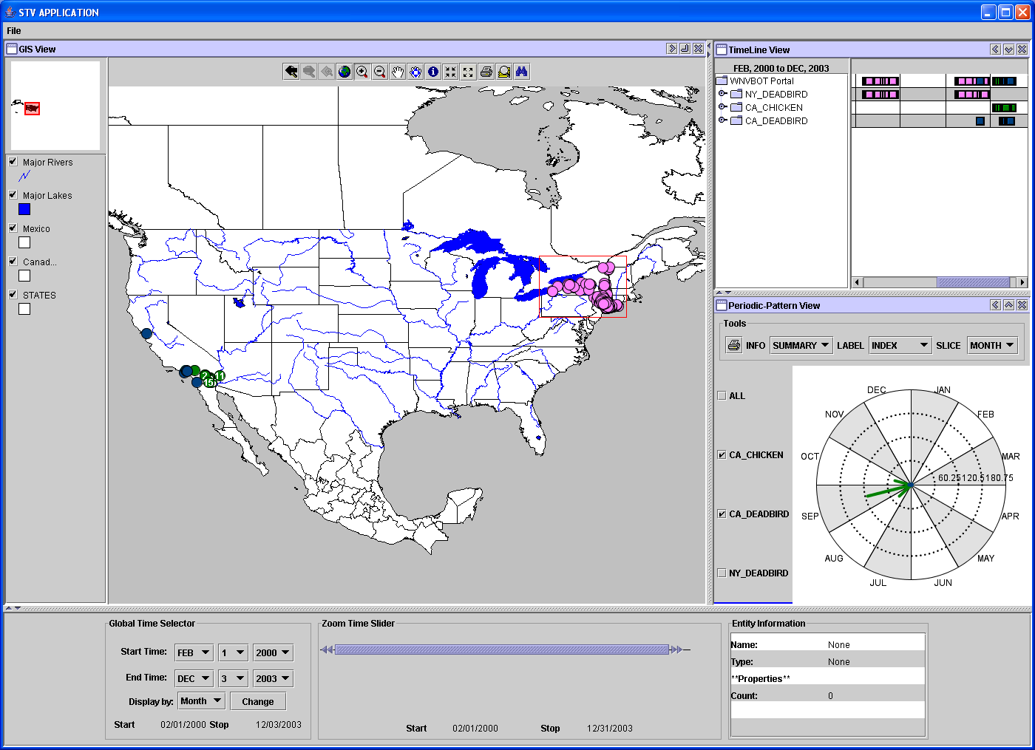
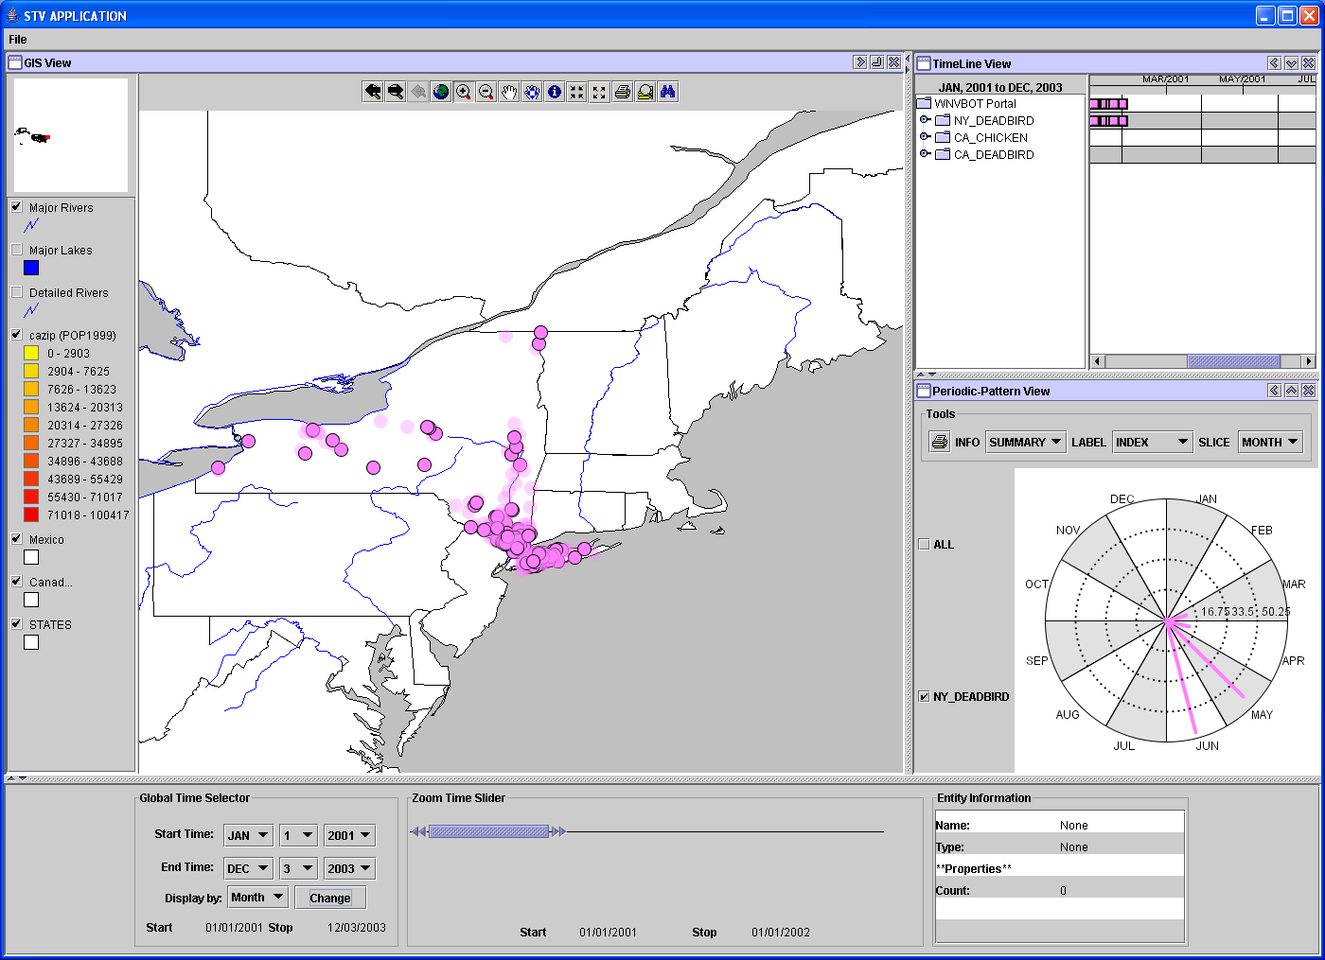

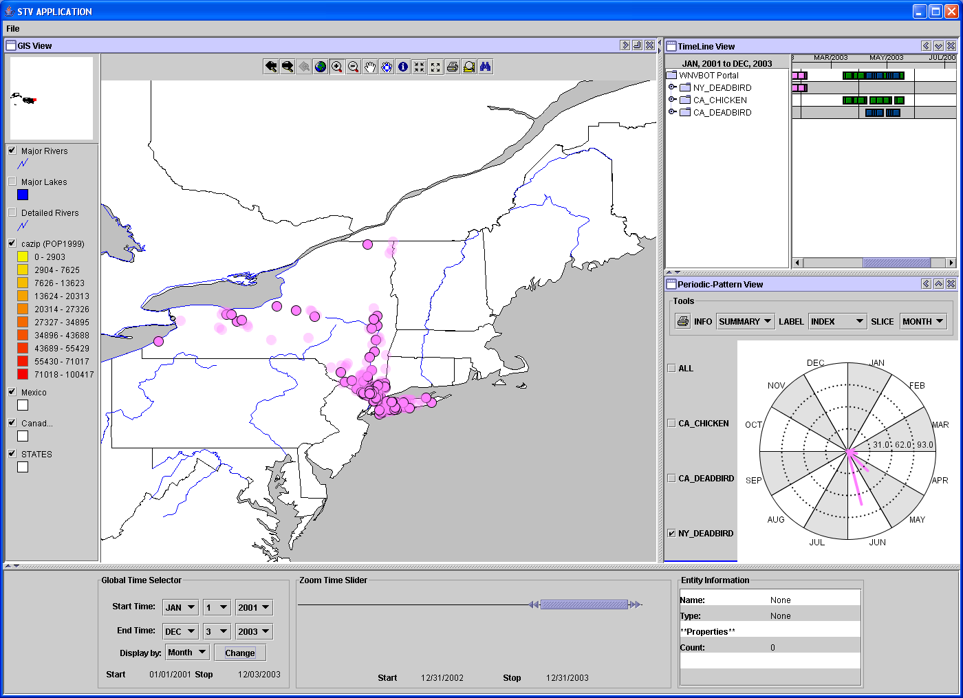
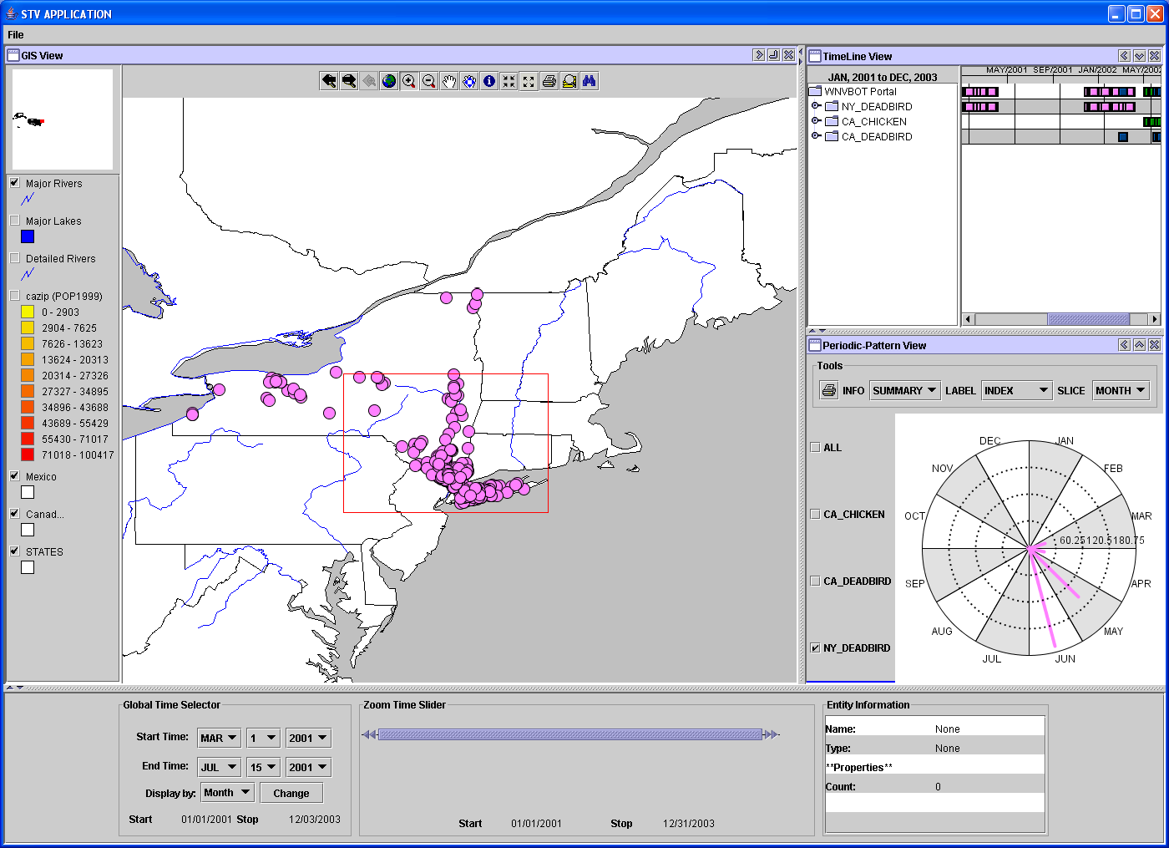
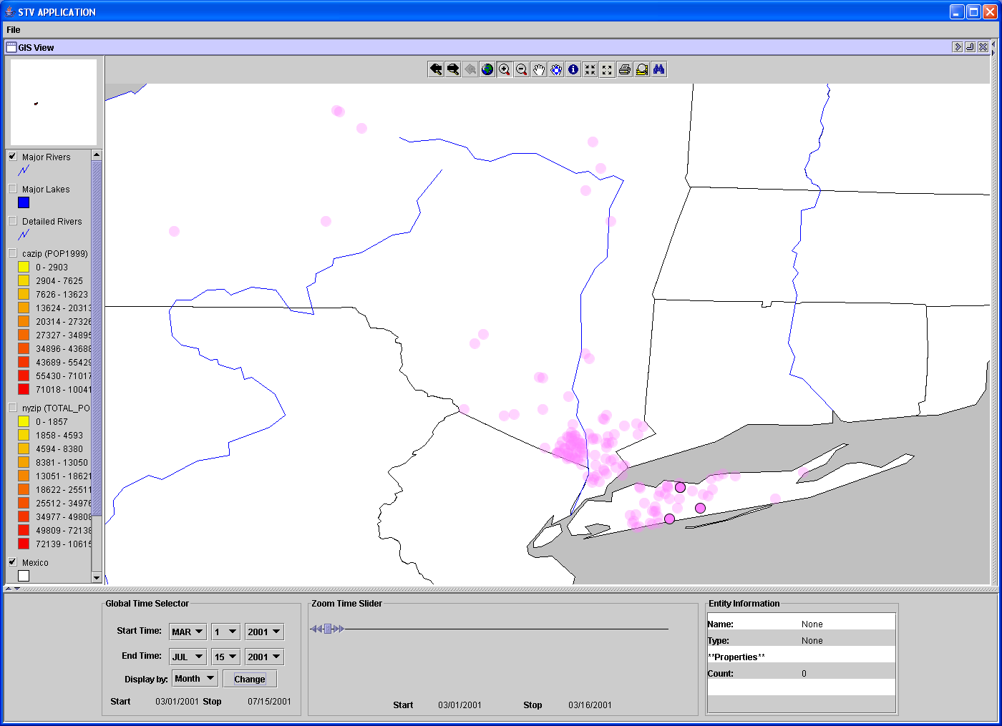
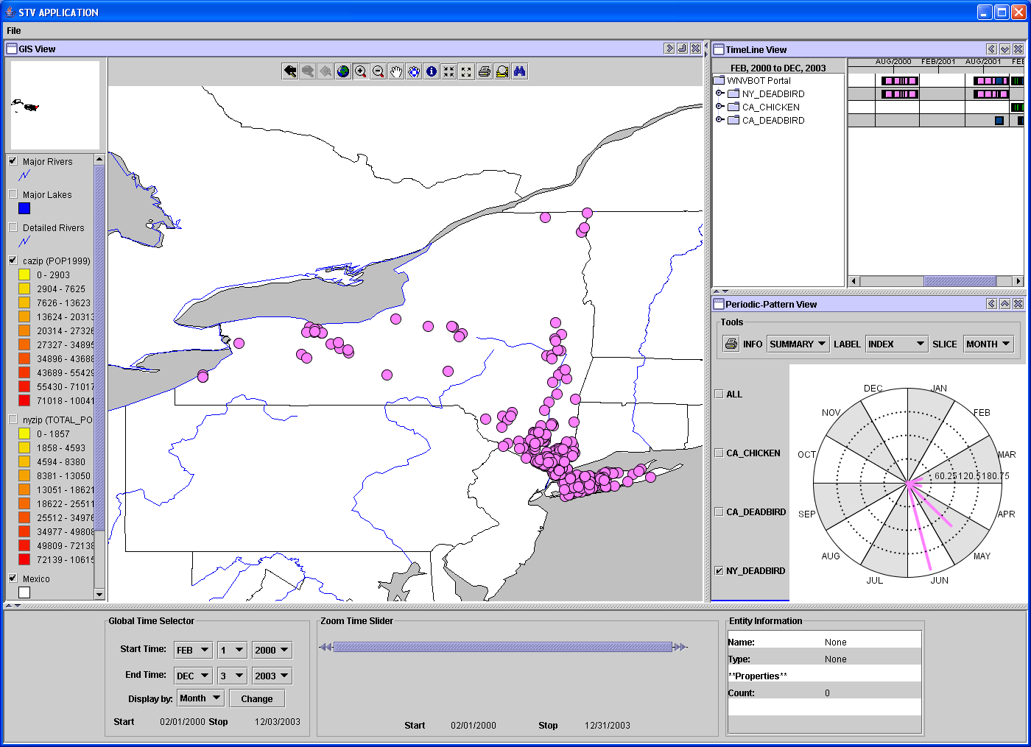
NY dead bird temporal
distribution pattern
NY dead bird temporal
distribution pattern
NY dead bird temporal
distribution pattern
NY dead bird temporal
distribution pattern
Spatial distribution
pattern
Spatial distribution
pattern
GIS
Spatial distribution
pattern
Timeline
Close
Close
Zoom in NY
Zoom in
Periodic
Pattern
Year 2001 data
Move time slider, year 2
Move time slider, year 3
Overall pattern
Concentrated in May / Jun
Similar time pattern
Similar time pattern
Control
panel
2 weeks window
View all 3 year data
1 year window in 3 year span

Slide 28



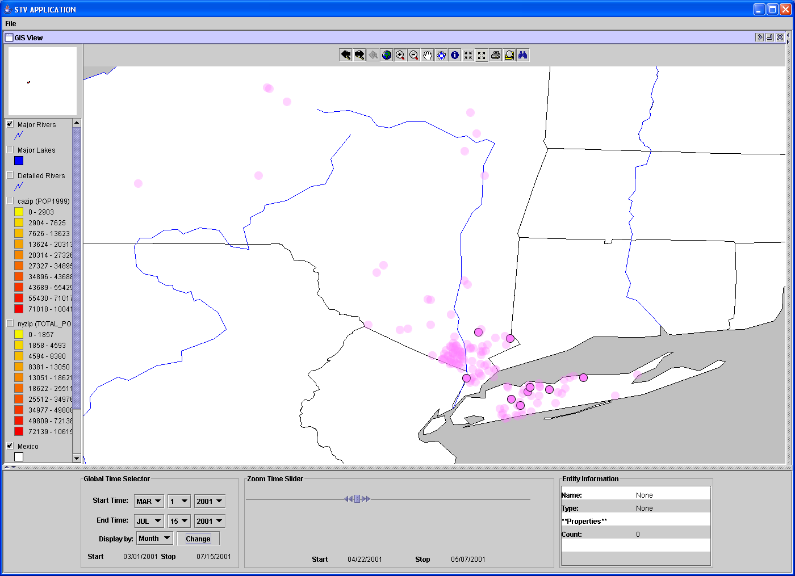

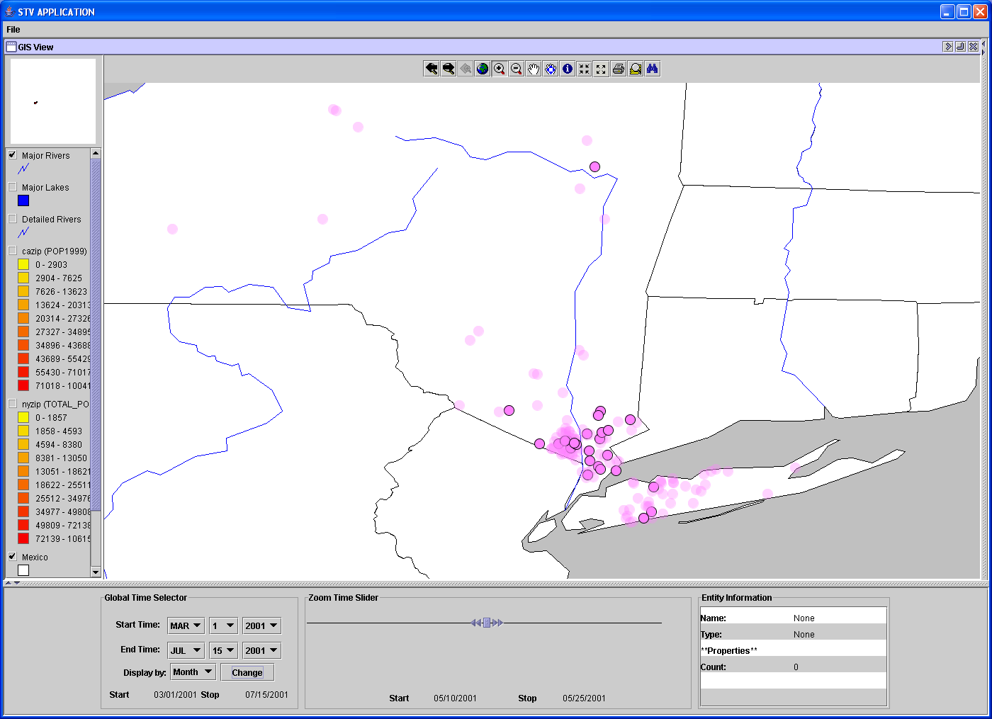
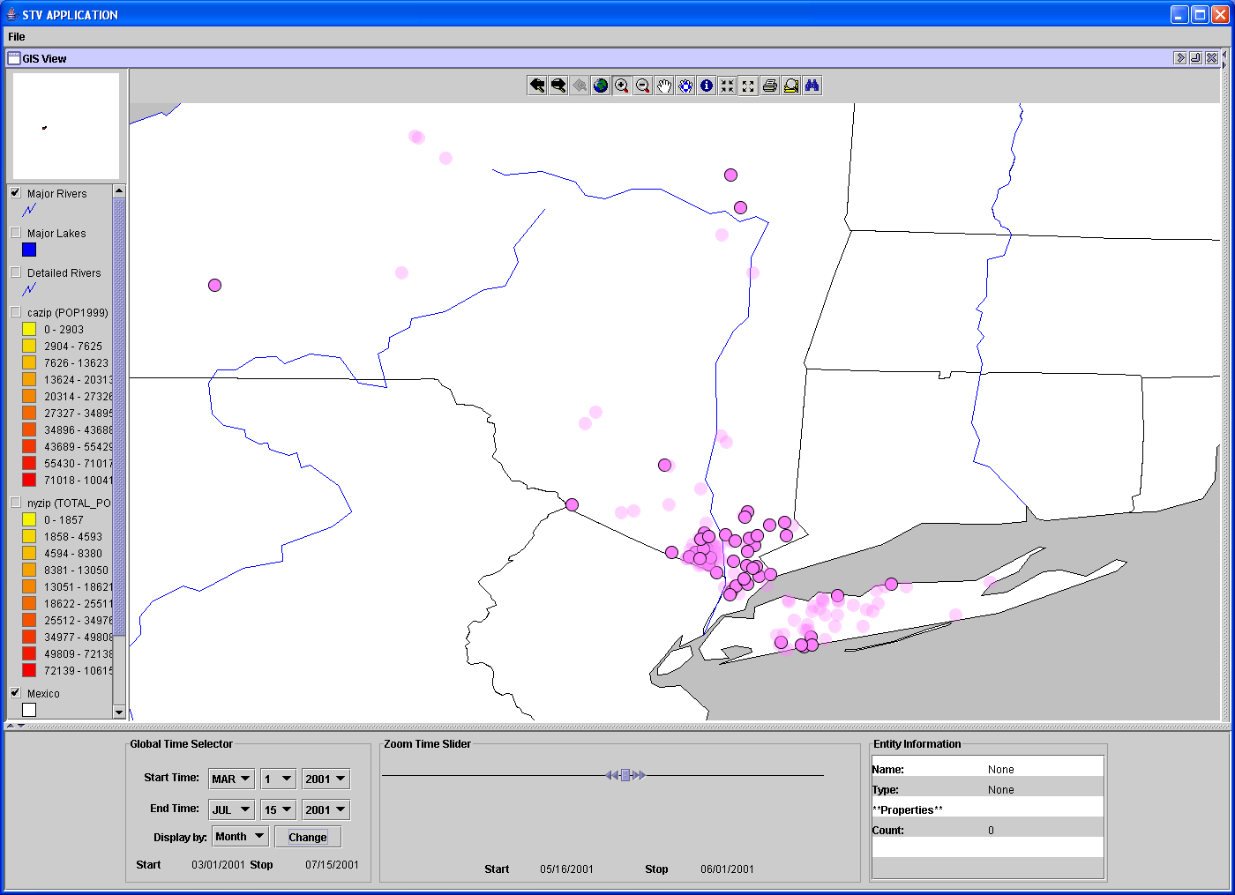



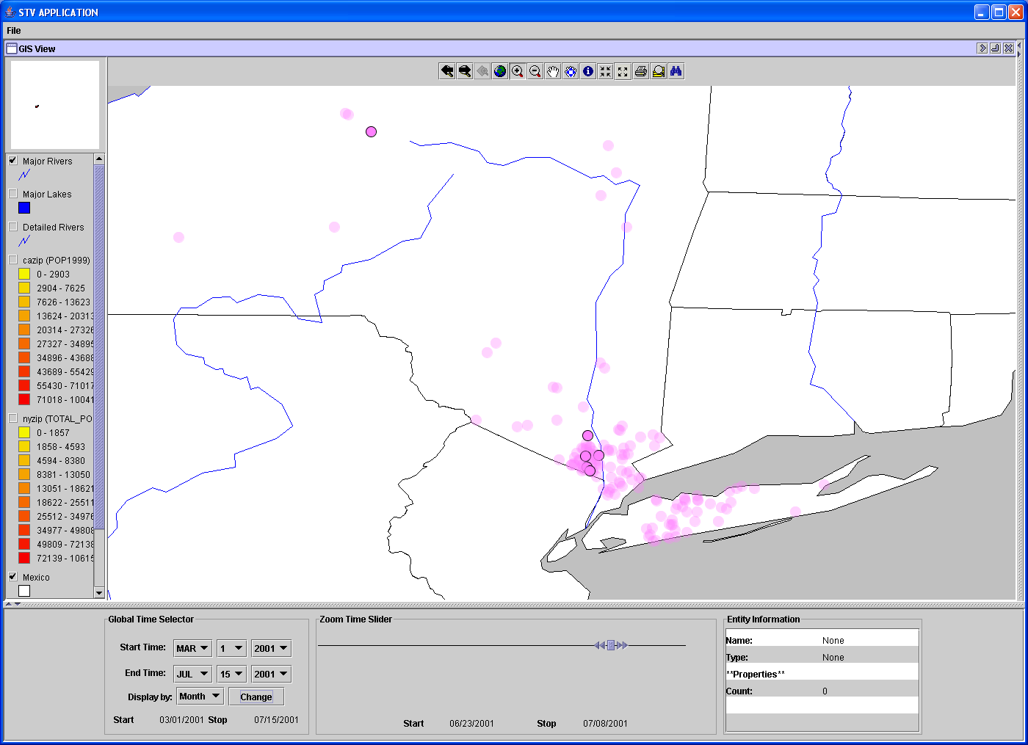
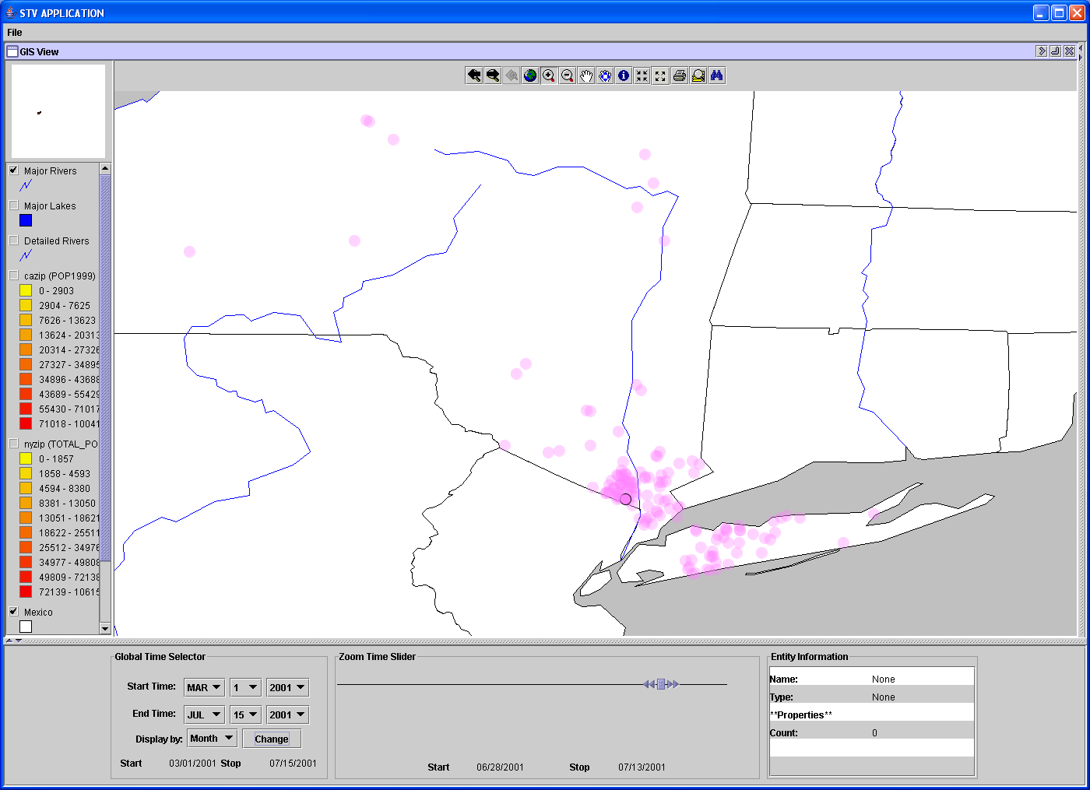
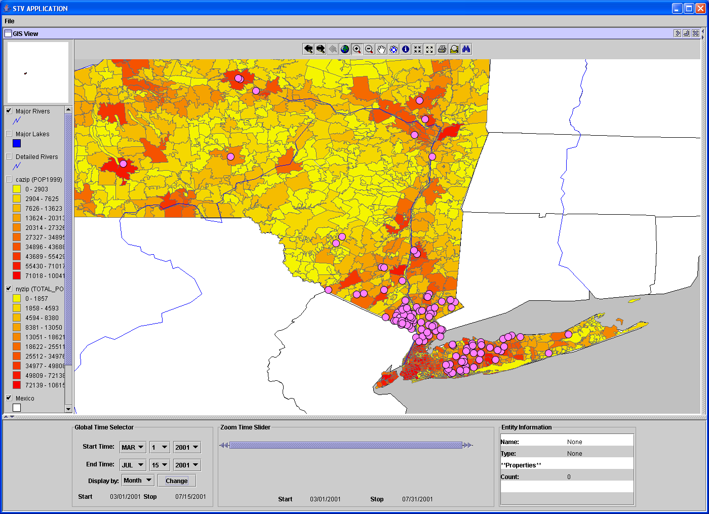
Spatial distribution
pattern
Spatial distribution
pattern
Spatial distribution
pattern
Spatial distribution
pattern
Spatial distribution
pattern
Spatial distribution
pattern
Spatial distribution
pattern
Spatial distribution
pattern
Spatial distribution
pattern
Spatial distribution
pattern
Spatial distribution
pattern
Spatial distribution
pattern
Spatial distribution
pattern
Overlay population map
Dead bird cases
migrate from long island
Into upstate NY
Dead bird cases
distribute along
populated areas near
Hudson river
Enable population map
Season end
Move time slider

Slide 29
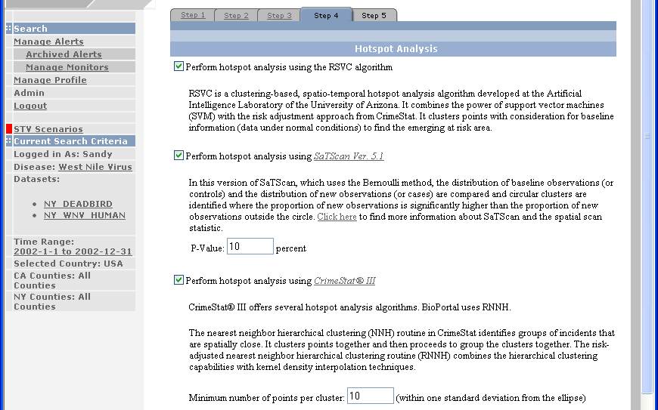
BioPortal HotSpot Analysis: RSVC, SaTScan, and CrimeStat Integrated (first visual, real-time hotspot analysis system for disease surveillance)
West Nile virus in California

Slide 30
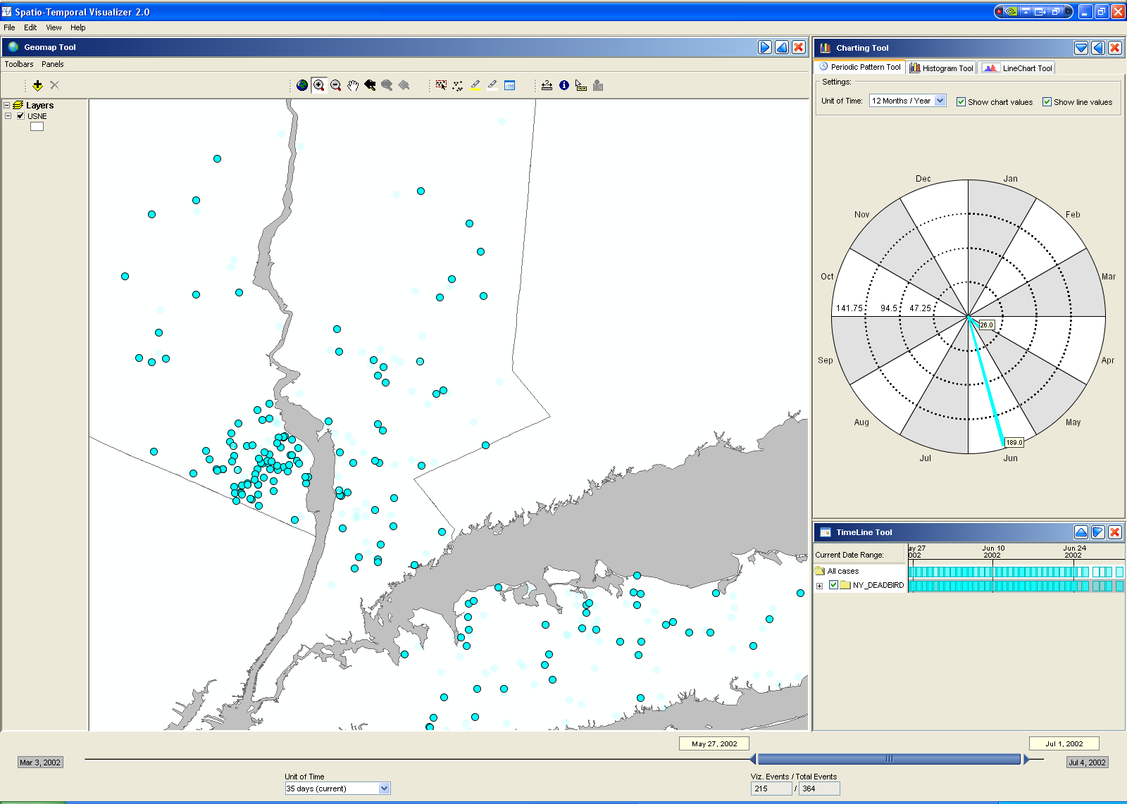




Hotspot Analysis-Enabled STV
Select hotspot to highlight case points
Regular STV
Select algorithms
Hotspots found!
Select baseline and case periods
Select baseline and case periods
Select target geographic area

Slide 31
BioPortal – FMD
(across regions; phylogenetic tree and news)

Slide 32

FMD Global Surveillance: Lessons Learned
Must understand risks, and nature of changing risks, in order to develop strategies for prevention and mitigation on a global scale
Must understand the global situation in order to prepare locally
United Kingdom FMD outbreak, 2001; $12B, 50-60% of 4M farm animals (cows, pigs, sheep) slaughtered

Slide 33




Global FMD Coverage in BioPortal

Slide 34





FMD Migration Visualization using BioPortal (cases in South Asia)
FMD Cases travel back and forth between countries

Slide 35

BioPortal-Afghanistan

Slide 36


Sample FMD
Sequence Records
Color-coded View (MEGA3)
Textual View of Gene Sequence

Slide 37

Phylogenetic Tree of Sample FMD Data
Identify 6 groups
within 2 major families (MEGA3; based on sequence similarity)
Group6
Group1
Group5
Group2
Group4
Group3

Slide 38

Genetic, Spatial, and Temporal Visualization of FMD Data
Phylogenetic tree color coded
Isolates’ locations color coded
Isolates’ appearances in time

Slide 39
BioPortal: Influenza, SARS
(chief complaint syndromic surveillance, contact network analysis and visualization)

Slide 40

Chief Complaints Grouped by Hospitals in Taipei, Taiwan

Slide 41

Grouped by Syndrome Classification

Slide 42

Taiwan SARS Contact Network Visualization over Time
Social network visualization with patients and geographical locations
Scroll bar on time dimension to see the evolution of a network

Slide 43

Taiwan SARS Network Evolution – Hospital Outbreak over Time
The index patient of Heping Hospital began to have symptoms.

Slide 44
BioPortal Information
Dr. Hsinchun Chen hchen@eller.arizona.edu
UA/Eller AI Lab project information http://ai.arizona.edu
Hsinchun Chen, et al., 2010

